Slide 1

Winter Salt Management
September 13, 2023
PAST, PRESENT, AND THE FUTURE…
Notes:
Introductions…..

Slide 2
The Three Questions for Today
Where were we?
Where are we?
Where do we want to be?
Notes:
Where were we? Where are we? Where do we want to be? The first two questions we can answer using historical data and the years of internal expertise right here in this room. The last one could be a bit tricky though due to the unknown factors like budgets, employee turnover, regulations, new equipment and technologies, etc. but we need to have some sort of direction that we can present when asked.

Slide 3
Equipment

Slide 4
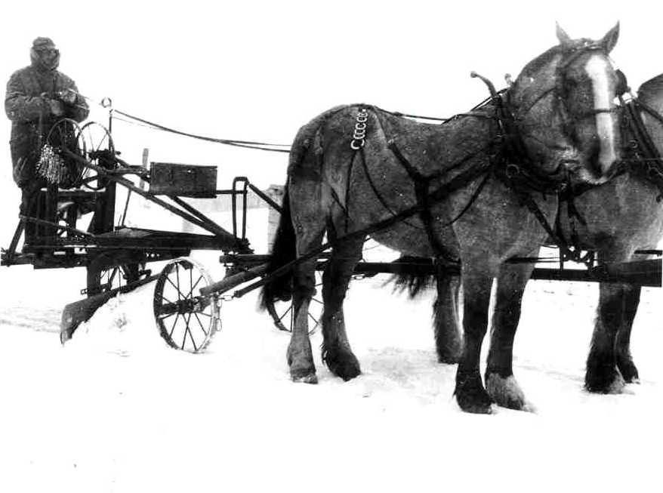
SOUTHERN DISTRICT SNOW OPERATIONS
Notes:
How up-to-date is your equipment?
How up-to-date is your knowledge on winter maintenance equipment and what’s available?

Slide 5
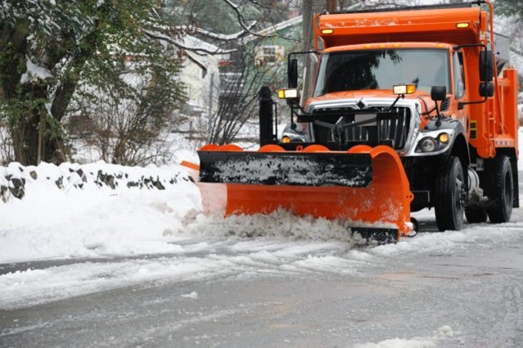
Equipment from the Present
Notes:
At the current time SHA has a modern fleet of snow fighting equipment and it is ever evolving.

Slide 6
Road Salt Historical Trends

Slide 7
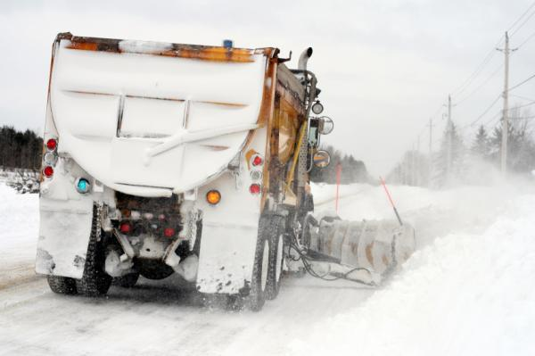
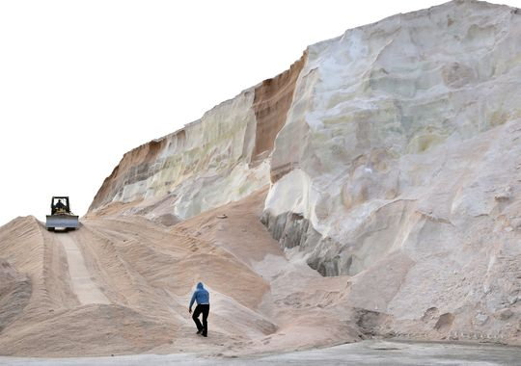
Road Salt Usage
>20 million tons annually
Maryland application guideline:
  300-500 Ib/lane mile/storm
US: Not classified contaminant
Canada: Is classified contaminant
http://www.postgazette.com
Notes:
Drive home the point that other countries are actually calling road salt a pollutant/contaminant. It is not long until or federal EPA and environmental agencies are lobbying for this same type of legislation.

Slide 8
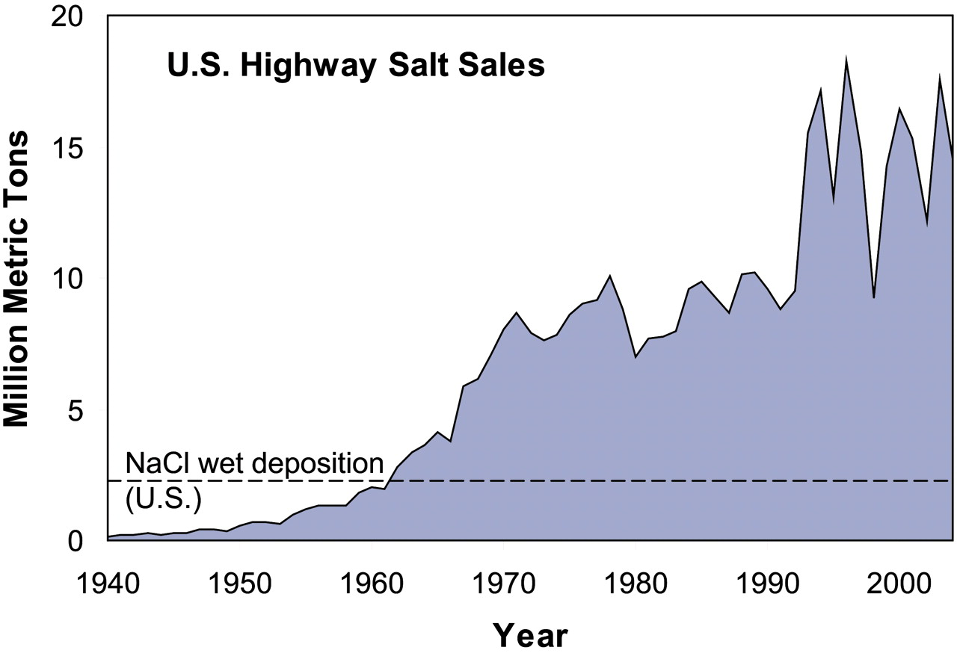
Increased road salt use over last 70 years
Began 1938 in NH
Notes:
Explain this chart and how in the beginning there were not as many roads to treat…

Slide 9
Increased road salt use over last 70 years
Began 1938 in NH
Notes:
By 1970 sales had quadrupled and our applications had began to exceed he USGS recommended levels.

Slide 10
Increased road salt use over last 70 years
Began 1938 in NH
75% all US salt applied in IL, MI, NY, OH, PA, WI
Notes:
By 1990 and the early 2000’s sales had skyrocketed to 9 times the levels of 1960. This can be attributed to more roads and more resources but how much of it was from over utilization of those stockpiles and unneeded promises made to the public? It is not just MD that has a salt addiction. Look at those accrued numbers from just 6 other states.

Slide 11
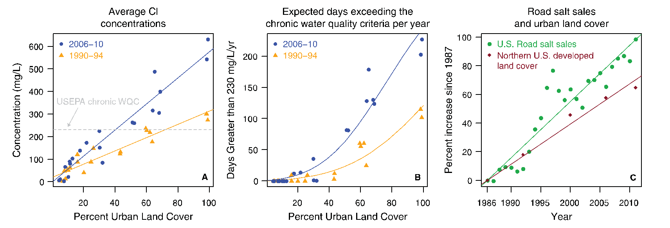
Increasing Cl concentrations across northern US
Road salt use growing 40% faster than urban land cover
Why? Changes in practice
Notes:
Explain the chart… Ask the questions… Why is this happening the data doesn’t lie… Are we using to much? Over producing on LOS? Thoughts?

Slide 12
Road Salt Use Impacts

Slide 13
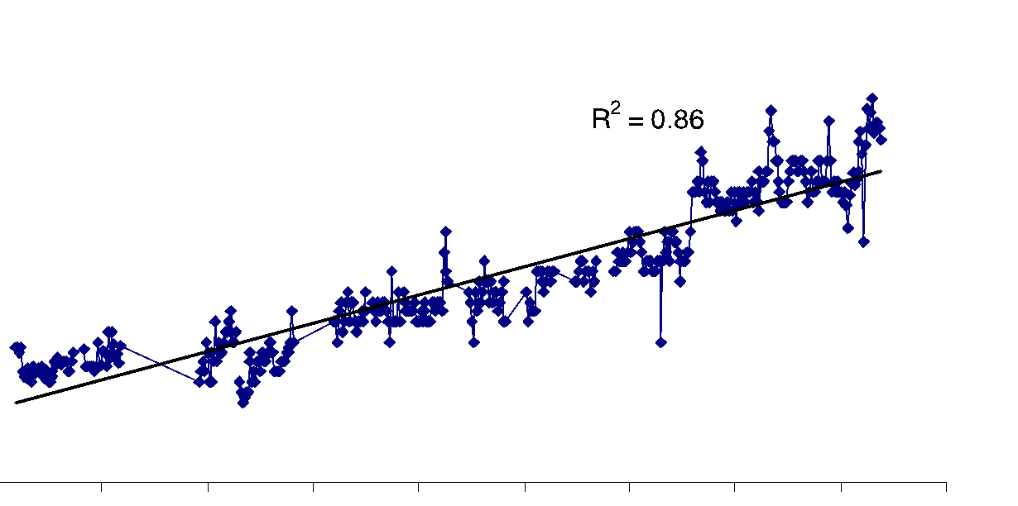

Increased road salt use & Cl – in streams
Rural rivers feeding Baltimore water supply reservoirs
3x increase [Cl–] since 1960
Notes:
It is no coincidence that readings from rivers feeding into the drinking supply reservoirs around Baltimore have tripled since 1960. Those readings go hand in hand with the increase in salt sold and used nationwide. Trends in data don’t lie over time and if we don’t change the trends in the data we might as well be drinking out of the ocean in few years.

Slide 14
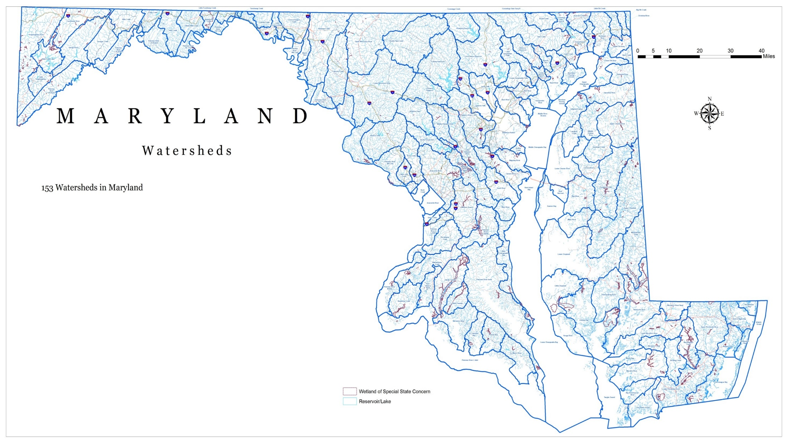
Notes:
There are 153 watersheds in MD. Do you all understand what water shed is? Explain to class if needed.

Slide 15
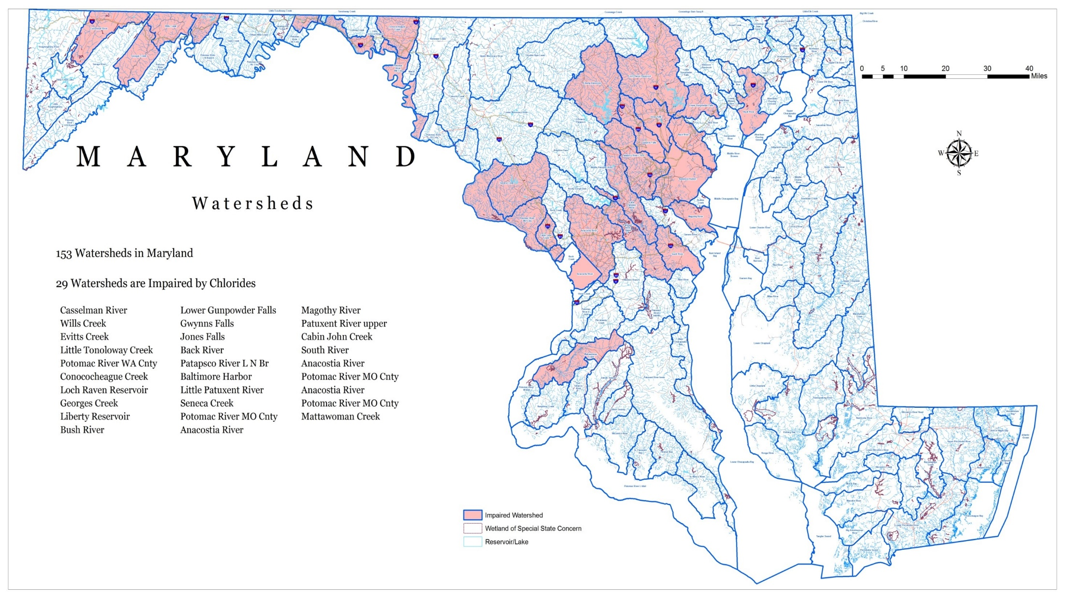
Notes:
As of right now 29 of those watersheds are impaired or not functioning at a healthy level for aquatic life or vegetation. They are all here outlined in red. Look at these and remember where they are.

Slide 16
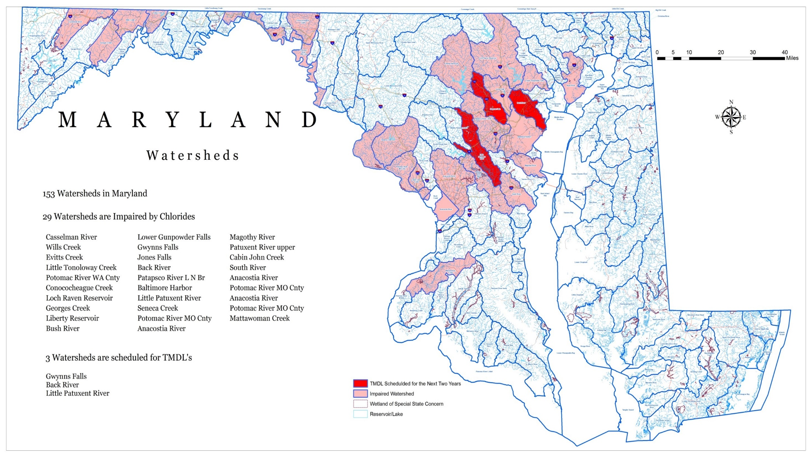
Notes:
The ones in dark red are the first proposed watersheds for possible TMDL sanctions in MD. Does everyone remember what a TMDL is? Explain to class if needed. These have not been implemented yet but have been tabled and the details are being worked out by multiple agencies. Stand by because it is coming…

Slide 17
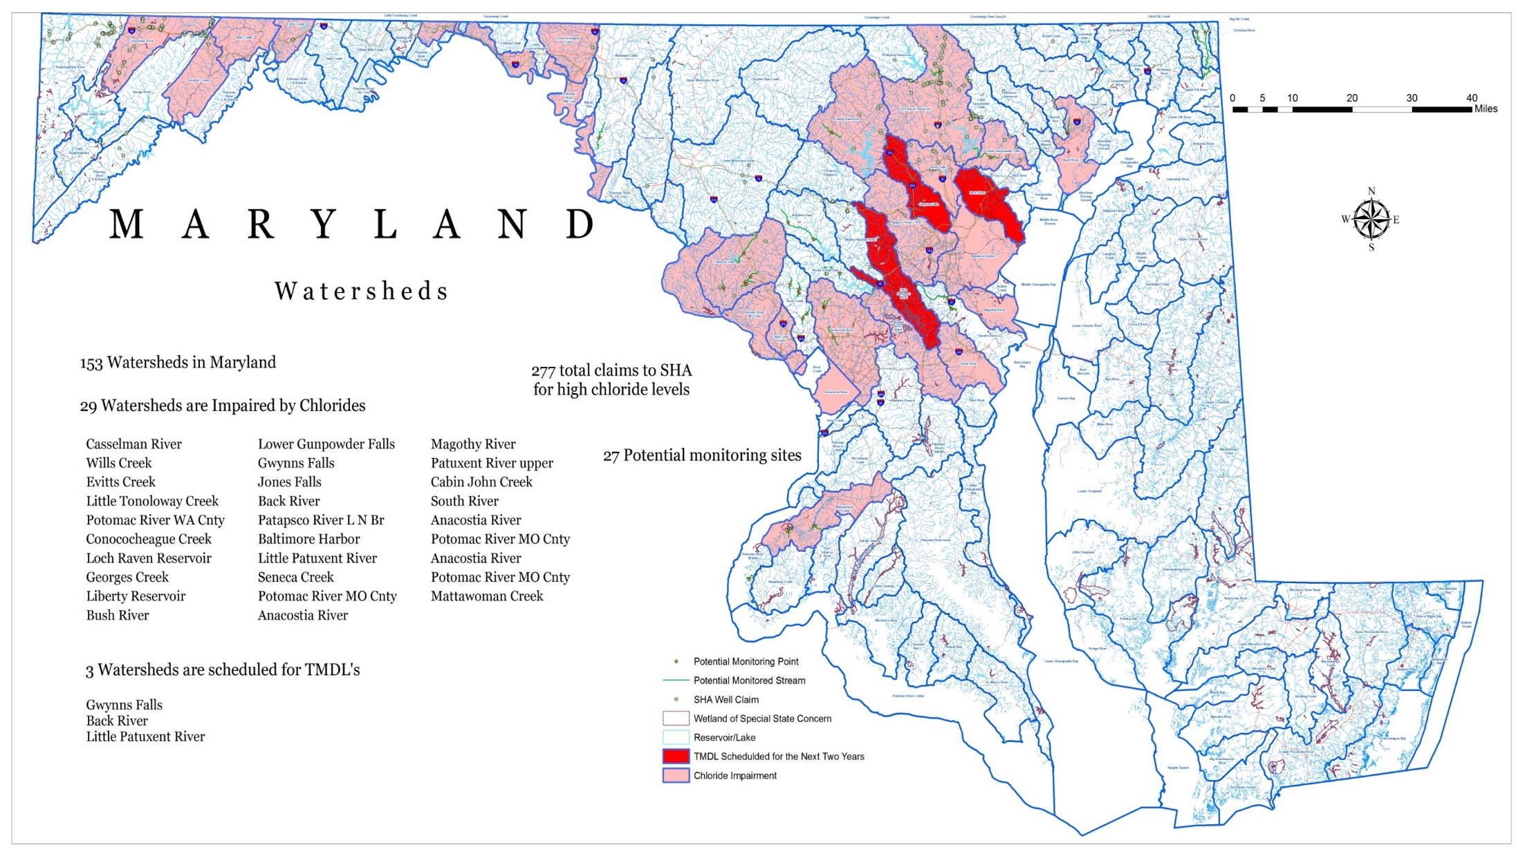
Notes:
It is kind of hard to see but as of last winter season SHA had 277 well contamination claims for high chloride levels. This picture is very telling as most of these claims fall within watersheds that have been found to be impaired by chlorides. Coincidence?? I think not. Does anyone know ballpark how much it costs to replace a well at a residence? 25000 dollars is in that ball park. Do the math. Not a cheap thing to fix it we are found to be at fault.

Slide 18
Notes:
The conductivity of the river increased both upstream and downstream during and after the snow event on March 14-15 – likely from run-off occurring further up in the watershed. Except for the early hours of March 14, higher conductivities were measured downstream of MD 147.

Slide 19
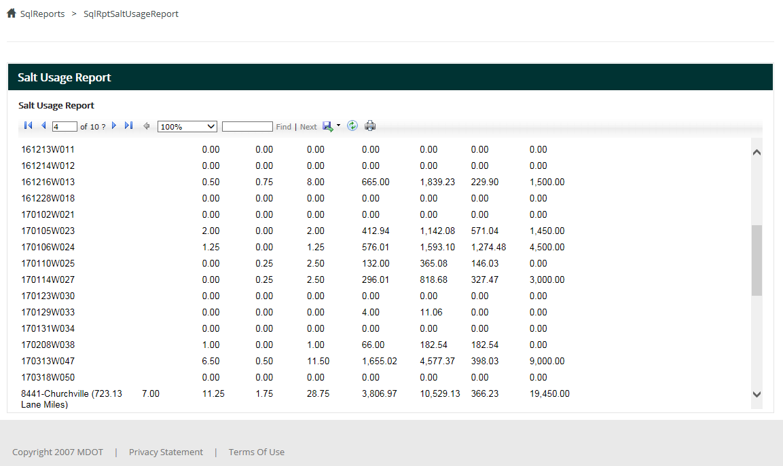

Slide 20
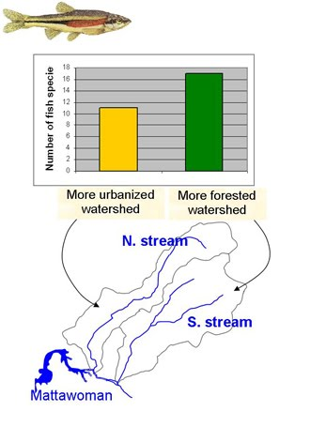
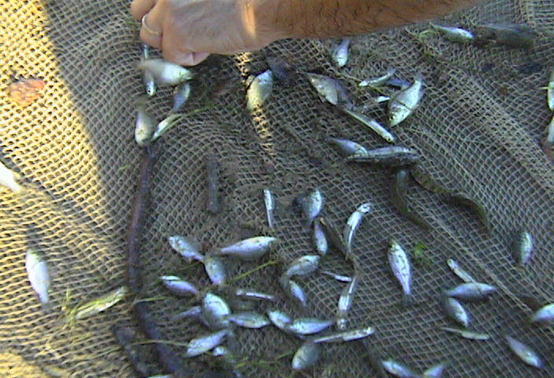
Impacts : Fish (anadromous / migratory)
Chloride may make it harder for herring to find their freshwater spawning environments (MDE)
Notes:
Biological response to land development: fewer fish species
The charts below tell that the number of fish species declines significantly when a watershed is developed.
In the early part of the 21st century, Mattawoman's river and estuary had a healthy total of 54 species of fish, in the top 6% of comparably sized Maryland watersheds. This number may be declining, as the number of species in the estuary began to drop dramatically around 2005 from over-development of the watershed. A smarter-growth land-use plan, and protection of the stream valley, is needed to stem the fall and to set the stage to reverse the trend.

Slide 21
Long Term Effects
I. Environmental Impacts
  Ecosystems
  Reservoirs / Drinking water
  Chesapeake Bay TMDL’s
  Well contamination
II. Equipment Impacts
  Wear and tear
  III. Infrastructure Impacts
  Bridge and roadway deterioration

Slide 22
Salt Management Plans

Slide 23
Statewide Salt Management Plan
A document that was created By SHA due to legislation passed in 2011.
Explains in detail MDOT SHA’s best practices in regards to training, environmental impact, equipment usage, storage/containment, and data analysis.
Has been updated as needed reflect changes in trends and our environmental stewardship goals.

Slide 25
Notes:
Talk about the usage rates from other surrounding states and explain in detail how we got to where we are now. Need to elaborate that yes we are making great strides in reductions but we have a long way to go and we can not do it without buy in from the top.

Slide 26
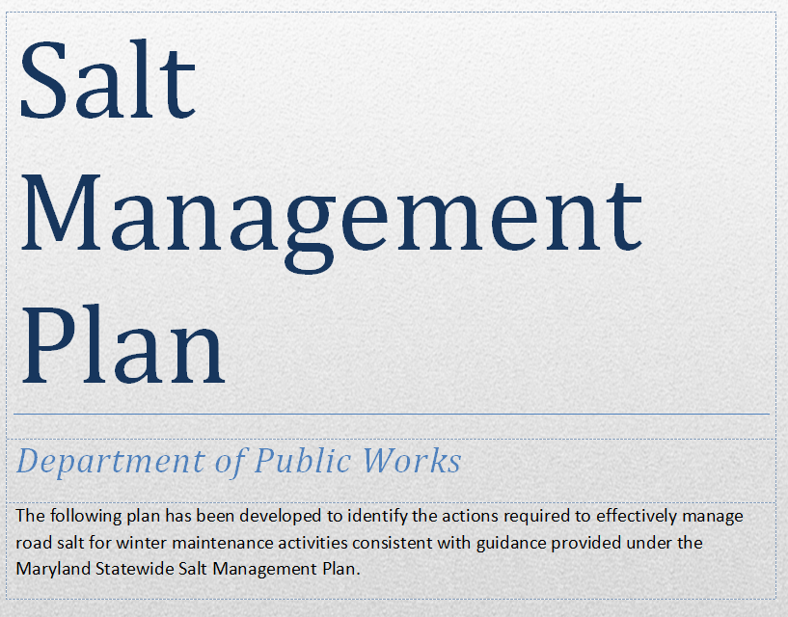
DPW Salt Management Plan
In 2014, subsequent to the promulgation of the Statewide Salt Management Plan, the Bureau of Highways developed the Department of Public Works Salt Management Plan to outline the practices intended to effectively manage road salt for winter maintenance activities within the County.
Plan Goals
  Public Safety
  Environmental Protection
  Efficient Transportation System
  Fiscal Responsibility
  Continuous Improvement

Slide 27
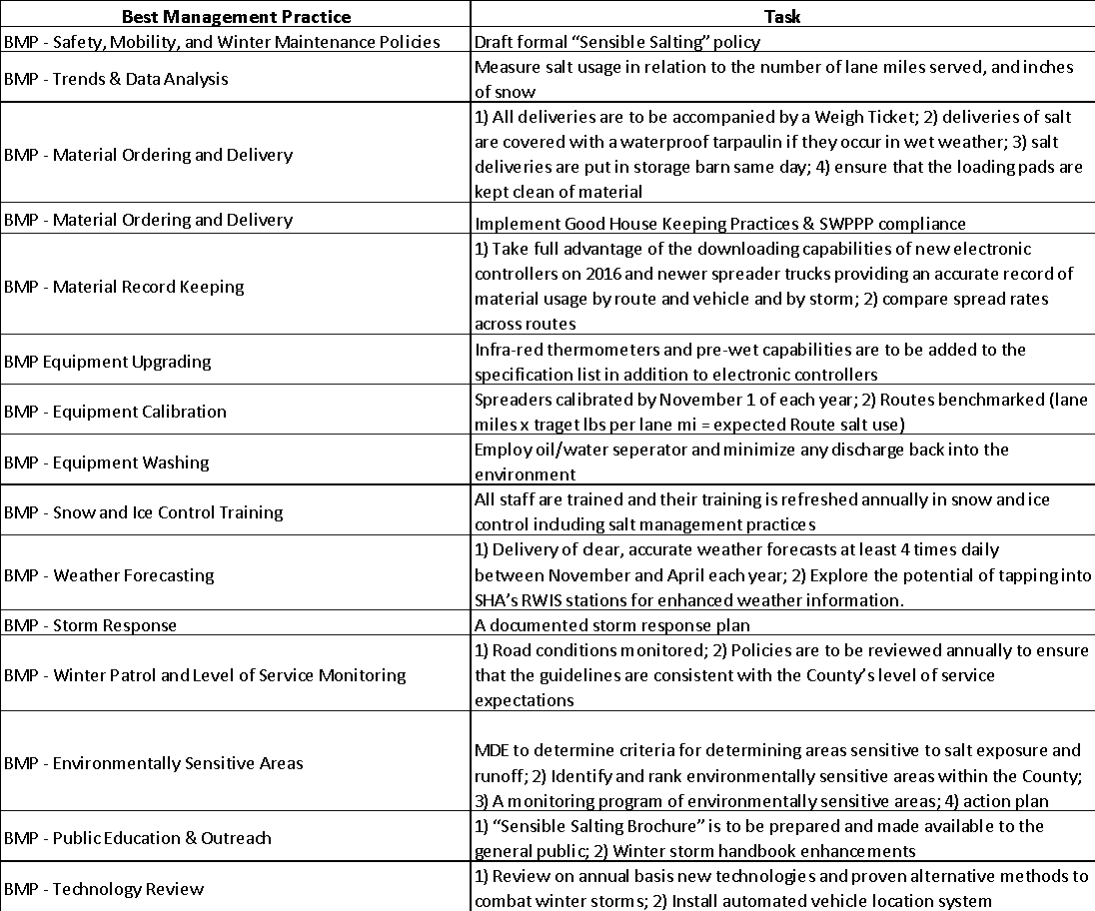
Plan
Tasks

Slide 28
YOU HAVE the most control over
Road Salt Management
“Sensible Salting” conserves our limited supply of material and provides:
  Safety and mobility for motorists;
  Environmental stewardship; and
  Fiscal responsibility.
Notes:
Survival Lesson: Adopt “Sensible Salting” Practices
Adopting specific practices for plowing and spreading salt will be a great benefit in a variety of areas.
Sensible salting provides for “Professional Snowfighting and Snowfighters”.
Sensible salting protects the environment
Sensible salting increases safety at reduced costs
Sensible salting reduces liability
Sensible Salting Practices should be part of your Comprehensive Winter Operations Plan
Just what does “sensible salting” mean?

Slide 29
“Sensible Salting” is another way of saying: enough and no more.
Sufficient salt is required to produce the desired safety and mobility, the goal level-of-service. “Excess” applications add cost, but no further benefit, and harm the environment.
Limited Salting During the Late Evening/Early Morning Hours: From 11:00 p.m. - 4:00 a.m. very limited salting will take place, as salting is not as effective due to low traffic volumes. The goal of the Department during this time is to ensure passable roads, which means only intersections, hills, curves, and bridges will be salted. Beginning at 4:00 a.m., the Department prepares the roads for rush hour.
Limited Salting on Secondary Roads: Residential Roads (local streets) will be plowed as often as possible, but will only be salted at intersections, hills, curves, bridges, and school zones, AS NEEDED.
Proper Calibration of Equipment: All equipment will be calibrated to ensure that Sensible Salting Practices are implemented correctly.
    Goal is 200 lb/lane mile or less per application.

Slide 30
Snow, Ice or Frost Forecast | Pavement Temperature Range / Trend | Maintenance Action | Spread Rate
Light Snow Storm - less than 1/2 inch per hour | Above 32°F steady or rising | Treat icy patches if needed with chemical; plow if needed. | 100 lb/lane-mi
 | Above 32°F, 32°F or below is imminent | Plow as needed; reapply liquid or solid chemical when needed | 100 lb/lane-mi
 | 20°F to 32°F, remaining in range | Plow as needed; reapply liquid or solid chemical when needed | 100 lb/lane-mi
 | 15°F to 20°F, remaining in range | Plow as needed; reapply prewetted solid chemical when needed | 200 lb/lane-mi
 | Below 15°F, steady or falling | Plow as needed | Not Recommended
Light Snow Storm with periods of Heavier Snow | Above 32°F steady or rising | Treat icy patches if needed with chemical; plow if needed. | 100 lb/lane-mi
 | Above 32°F, 32°F or below is imminent | Plow as needed; reapply liquid or solid chemical when needed | 100L/200H lb/lane-mi
 | 25°F to 32°F, remaining in range | Plow as needed; reapply liquid or solid chemical when needed | 100L/200H lb/lane-mi
 | 15°F to 25°F, remaining in range | Plow as needed; reapply prewetted solid chemical when needed | 200L/250H lb/lane-mi
 | Below 15°F, steady or falling | Plow as needed | Not Recommended
Moderate/Heavy Snow Storm - greater than 1/2 inch per hour | Above 32°F steady or rising | Plow accumulation and reapply liquid or solid chemical as needed | 100 lb/lane-mi
 | Above 32°F, 32°F or below is imminent | Plow accumulation and reapply liquid or solid chemical as needed | 100 lb/lane-mi
 | 30°F to 32°F, remaining in range | Plow accumulation and reapply liquid or solid chemical as needed | 100 lb/lane-mi
 | 25°F to 30°F, remaining in range | Plow accumulation and reapply liquid or solid chemical as needed | 200 lb/lane-mi
 | 15°F to 25°F, remaining in range | Plow accumulation and reapply liquid or solid chemical as needed | 250 lb/lane-mi
FHWA Treatment Plan Guide

Slide 31
Level of Service

Slide 32
Salt Reduction Internal and External Outreach
Changing Leadership can bring changes in mindset
  Culture change from top to the frontline within the organization
  Tempered expectations
  LOS impacts
Showcasing to our customers the reasons why we are changing the way we do business
  Fiscal impact (Reduced usage rates have saved hundreds of thousands of $)
  Environmental impact
  Demand versus Supply
Notes:
How many of you have heard if your snow route wasn’t “running water” or “passable then you need to go hit it again? Those terms, even across Districts, was something that has been burned into our snow IQ as meaning you did a great job. Well we all know that words or phrases are all relative to the perspective of the person using the word or phrase. Previous Leadership would inquire when a road appeared to be covered and deemed not “passable” and want it wet pavement every time it was seen in the camera or on the news. Well I am here to tell you times have changed and so has the message / expectations.

Slide 33
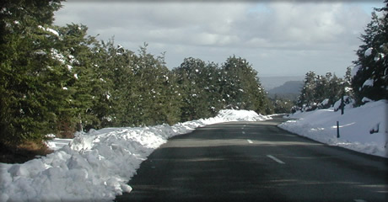
What is the LOS?

Slide 34
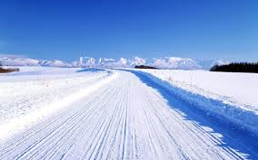
What is the LOS?

Slide 35
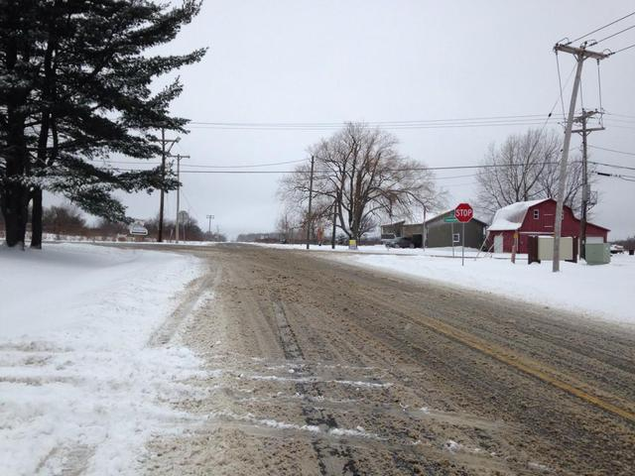
What is the LOS?

Slide 36
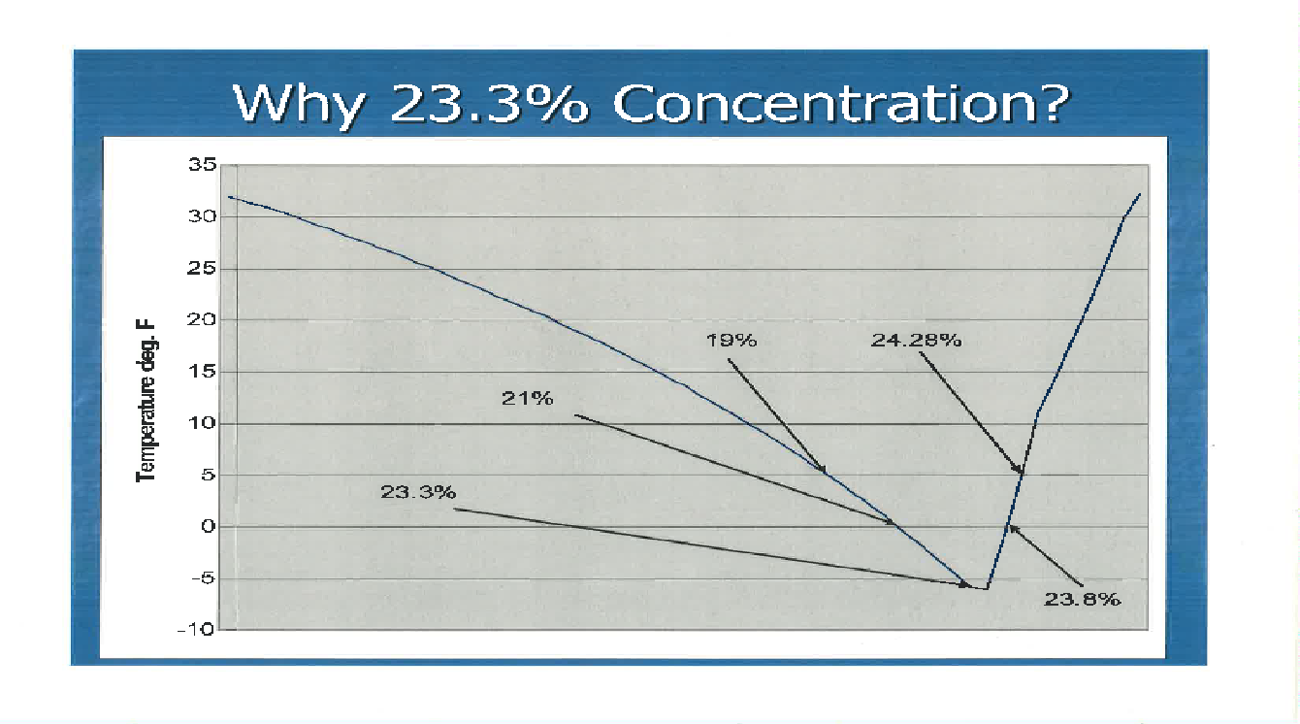
Dilution of the Solution
Notes:
Has anyone in the room heard or seen this before and can you explain it? Salt Brine needs to be made at a 23.3 % solution and properly has a freezing point of -6 degrees. The percentage of salt in the brine solution is one of the keys to success with the use of brine. Too much salt and the freezing point goes up, too little and the freezing point also goes up. There has been a lot of debate on the effectiveness of liquid applications in colder climates and I was a huge skeptic until I got to witness it work first hand on 15 degree day. I would be willing to bet that some of the failures others experienced were due to a solution that was just a few percent off of the optimum ratio.

Slide 37
Initiatives for Salt Reduction

Slide 38
New Initiatives for Salt Reduction
Loader Scale Pilot
  Tracks salt inventory at barns
Rubber Plow Blades with Carbon / Ceramic Inserts
  Reduces the amount of salt application needed
Brine Maker / Anti-Icing /Pre-Wet (Shower & On-Board Tank
Add storage capacity; Perfect salinity levels to maximize effectiveness
AVL Operations
  All County and Contractor dump trucks are reporting location; some will report salt usage (future)
Winter Contracts (Anti-icing, Snow Removal, Arterial Roadways, Salt)
New Equipment (Tri-Axles, 10-Ton Dumps, Spreaders, Brine Stations)

Slide 39
What Can We Do to Minimize Our Impacts
Establish a clear understanding of Level of Service measurement and temper the expectations of our customers
Expand on the success of our liquid anti-icing routes
Use of pavement temperature and pavement temperature forecasts to choose the right application rates
Accountability for improper practices
Proper calibration of ALL equipment (owned and contracted)
Notes:
I know that I am by far the not the best person to be up here preaching best practices with Resource Management. There is a lot of people in this very room with a whole lot more years experience than me. This is the kind of place where ideas and knowledge is passed. Any other thoughts or practices worth mentioning?

Slide 40
Prewet Facts
In the 1970s the Michigan Department of Transportation (MDOT) conducted a series of studies looking at how pre-wetting might impact the amount of salt left on the road after it was applied by a truck. They conducted tests on a closed three lane road, and drove down the center lane, collecting salt from that lane, and from the two lanes either side of the center lane, to determine dispersion. What they found was that when salt was placed dry (without pre-wetting) 30% ended up outside the three lane roadway (i.e. in the ditch) while when applied pre-wet, only 4% ended up in the ditch.
A second set of studies conducted in 2012 by MDOT essentially confirmed these findings.
Notes:
I know that I am by far the not the best person to be up here preaching best practices with Resource Management. There is a lot of people in this very room with a whole lot more years experience than me. This is the kind of place where ideas and knowledge is passed. Any other thoughts or practices worth mentioning?

Slide 41
Simply put, pre-wetting requires that a brine should be added to the road salt prior to it being placed on the road.
The bottom line for prewetting is that it allows an agency to reduce salt application rates by up to 30% without a reduction in levels of service.
There has been some very interesting work going on in Europe and in a few places in the US looking at using much higher rates of pre-wetting (from 30 to 70 gallons of brine per ton of dry material) to create a slurry of salt applied to the road. While this work is ongoing, it suggests that such higher pre-wet rates improve the retention of salt on the road, and enable it to act more effectively and efficiently to break the bond between snow and pavement and to prevent that bond from forming.

Slide 42
Information Links
http://clearroads.org/wp-content/uploads/dlm_uploads/0537_2015-Clear-Roads-Best-Practice-Guide-WEB.pdf
https://resources.forceamerica.com/library/Product%20Documents/Controls%20and%20Harnessing/Manuals/M0118-P%20-%20SSC5100ex%20Operation%20Manual.pdf

Slide 43

Prewet Systems

Slide 44
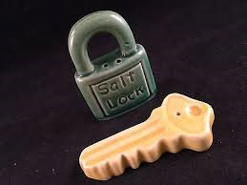
What did you do to help conserve salt???
QUESTIONS?

